Slide 1
Noise
CG2 - Medieninformatik
Mathias Krämer

Slide 2


Random Noise: Zufällige Werte ohne Zusammen-hang

Slide 3

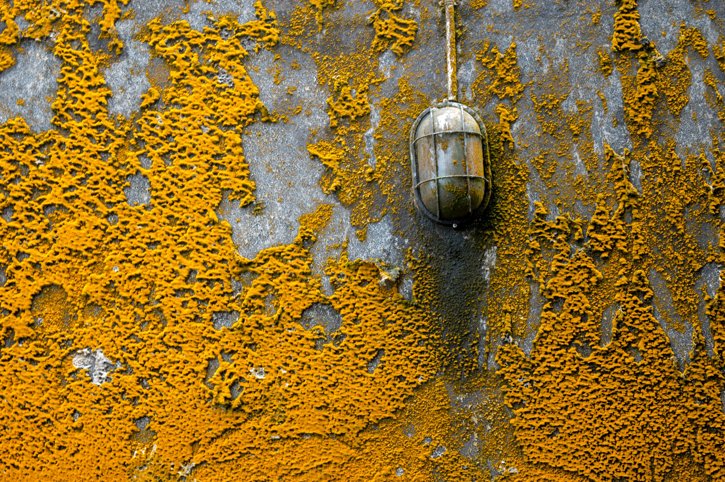


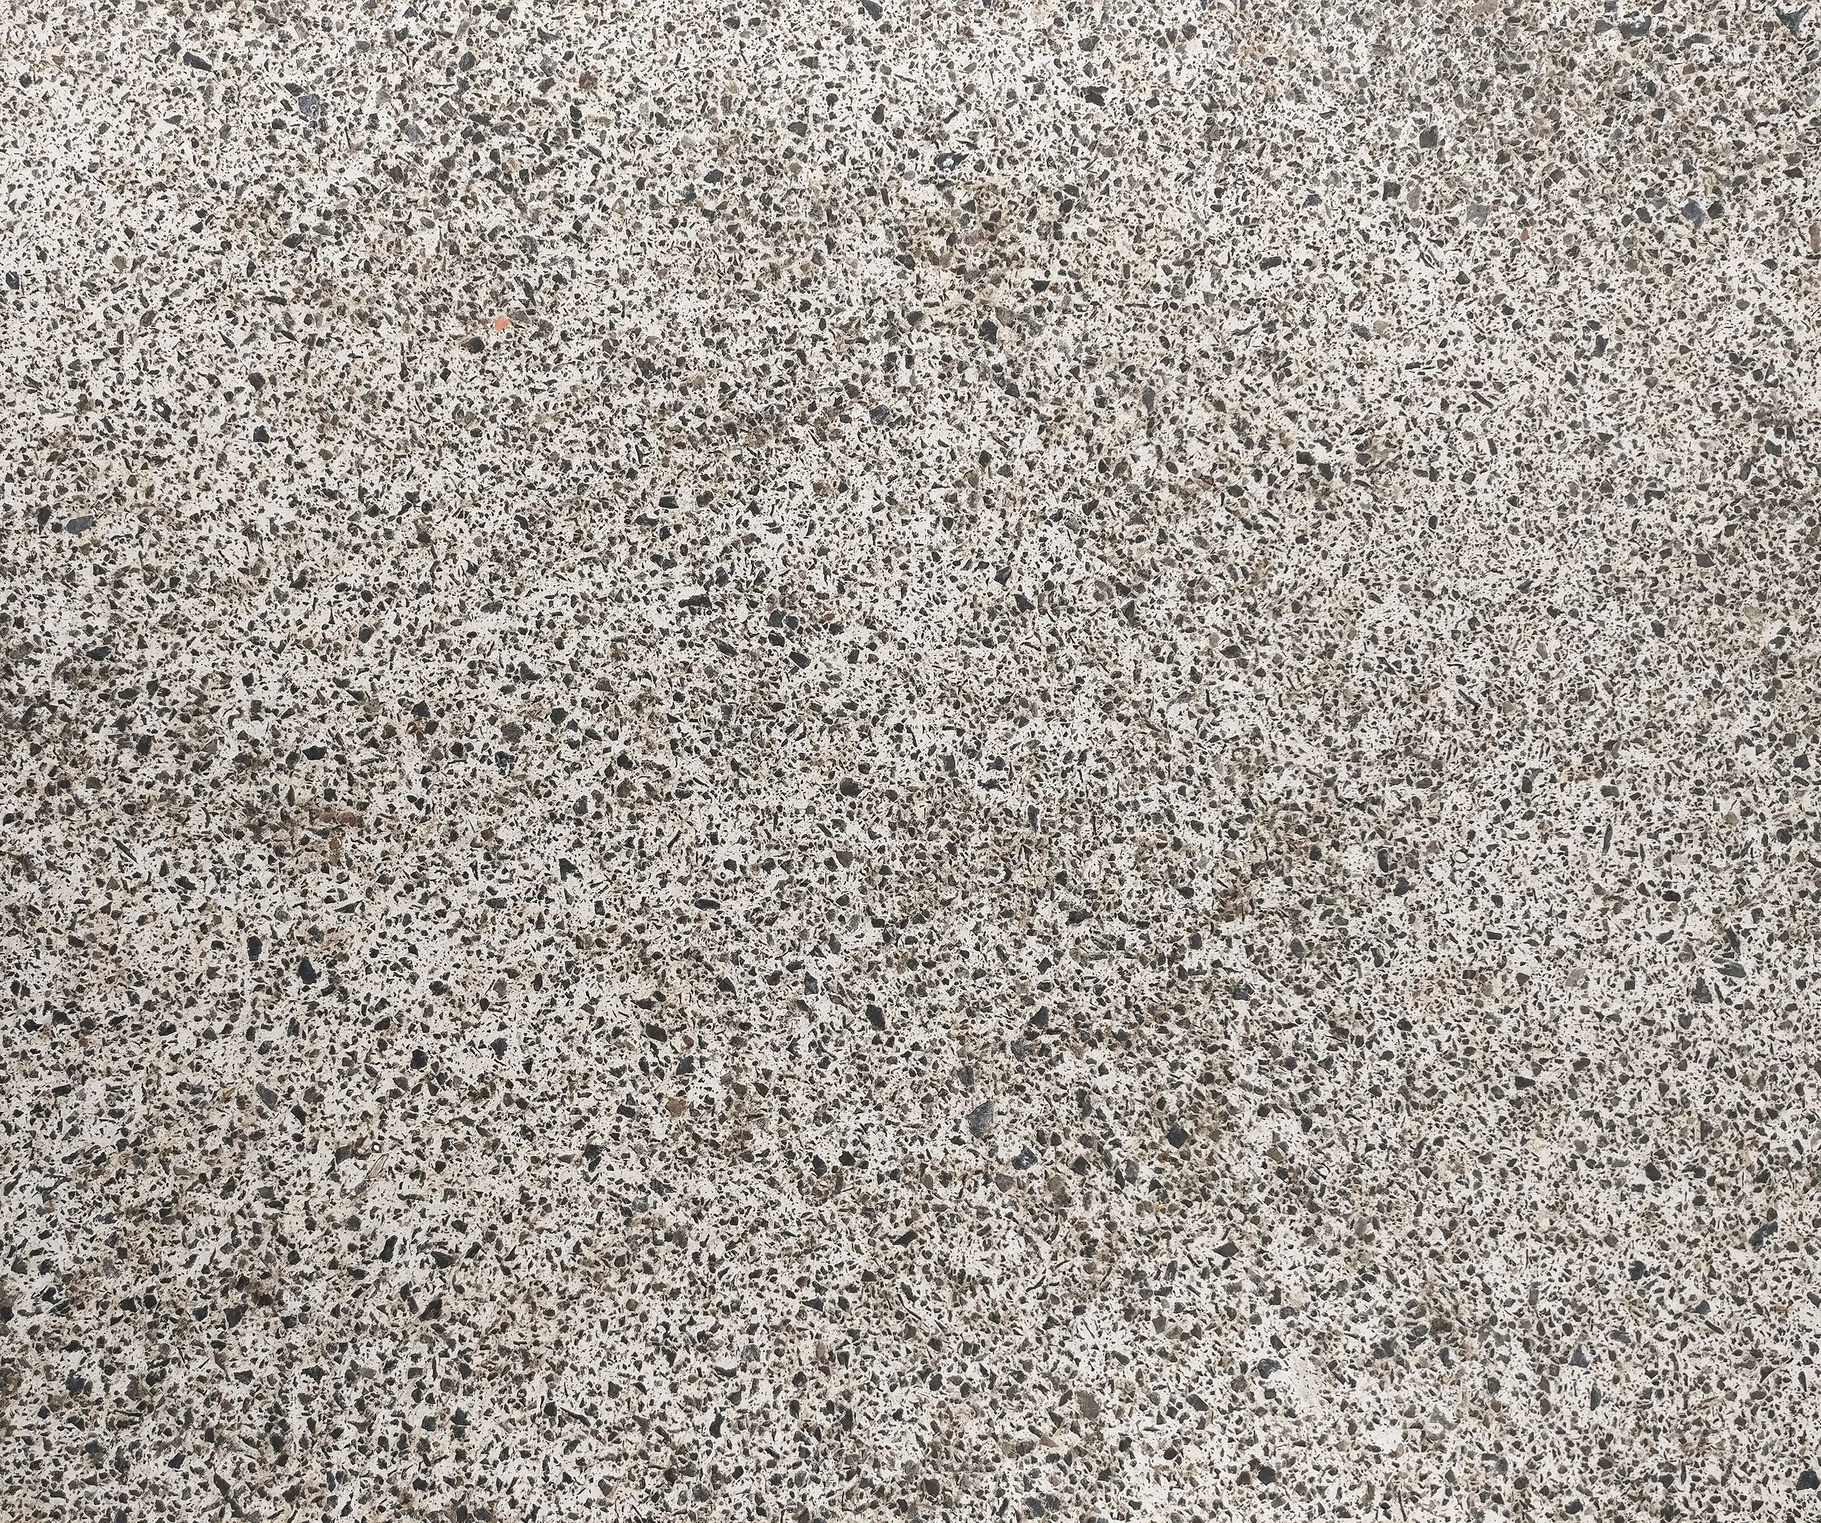
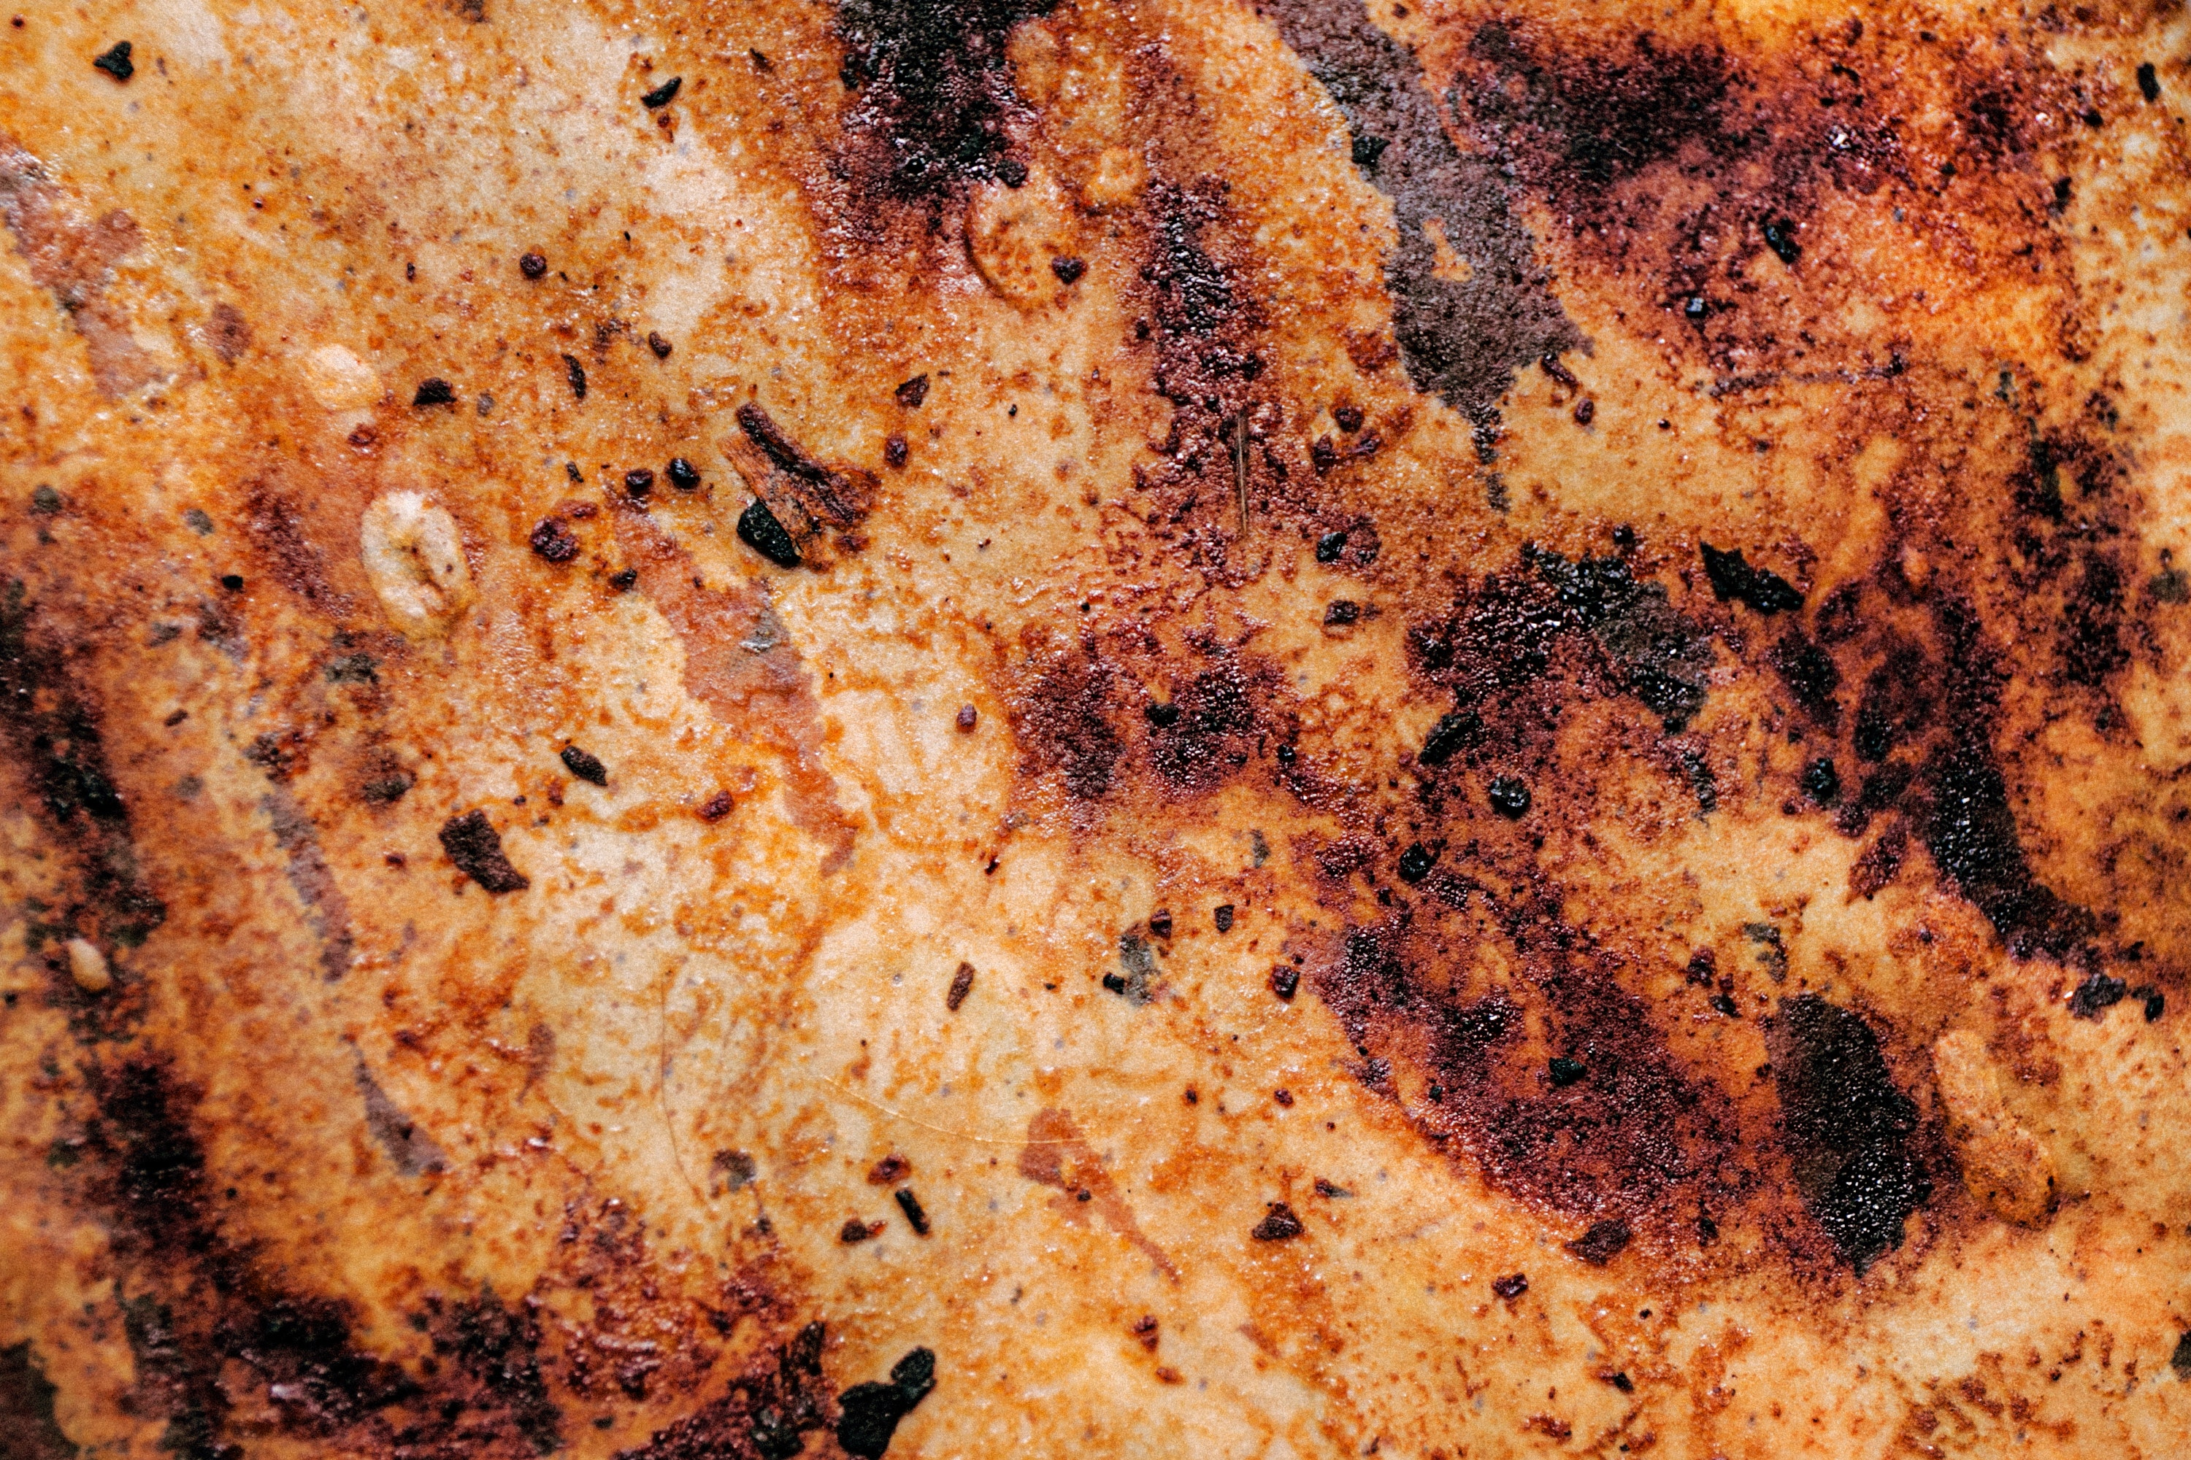
Src: https://www.pexels.com/ - free to use, no attribution required

Slide 4
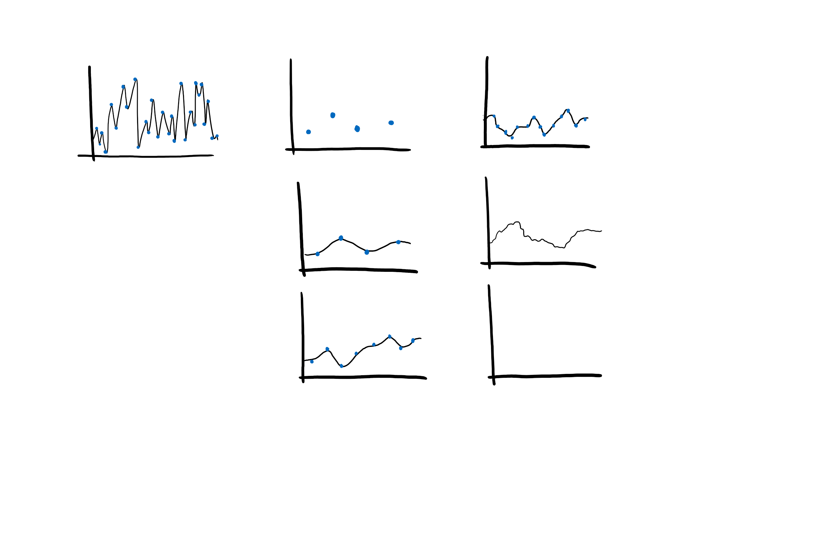
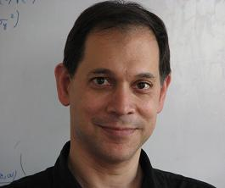
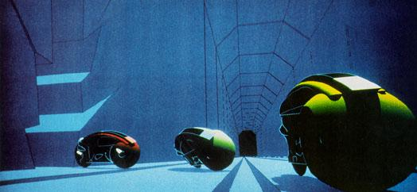
Ken Perlin: Perlin Noise
CG in movies (1982 - Tron)
Perlin Noise (stochastically coherent patterns )
Academy award for technical achievement for Perlin Noise (1997)
→
Random Noise
Perlin Noise
Src: Ken Perlin, https://mrl.cs.nyu.edu/~perlin/
Src: Ken Perlin, http://www.noisemachine.com/talk1/5.html

Slide 5
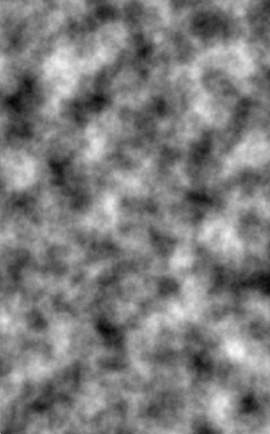
Perlin Noise
Pseudo-random noise used to create natural looking textures
Can be constantly differentiated
Procedural texture, can be described with an algorithm
Texturing primitive like a tool or paint brush
Pros:
No texture image is used (No bandwith for transmitting or storage)
Could be applied directly without texture mapping
n-dimensionality possible
Same output with same input parameters

Slide 6
Perlin Noise Algorithm
Schematically how it works (e.g. 2D implementation):
Defining a grid of random gradient vectors
Computing the dot product between the gradient vectors and their offsets
Interpolation of dot product values

Slide 7
Perlin Noise 2D | Step 1/3
1. Defining a grid of random gradient vectors
→
Loop through every pixel Perlin noise function, define color
Define grid on top

Slide 8
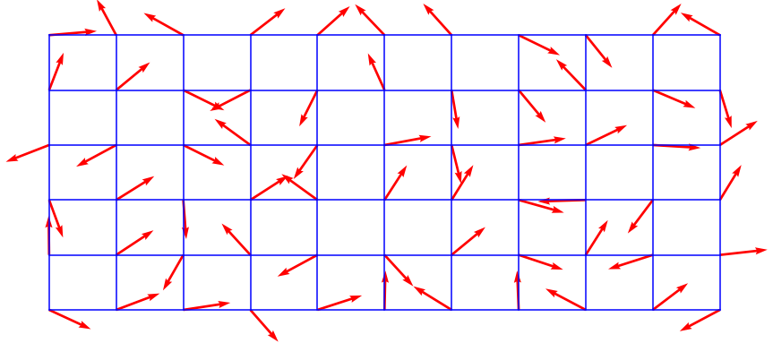
Perlin Noise 2D | Step 1/3
At each grid point a pseudo-random 2D gradient is picked
Source: By Matthewslf - Own work, CC BY-SA 4.0, https://commons.wikimedia.org/w/index.php?curid=77692522

Slide 9
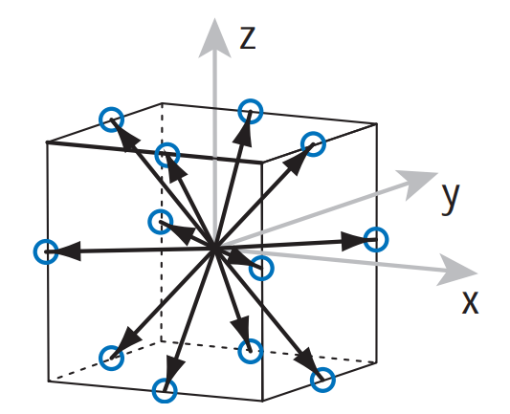
Perlin Noise 2D | Step 1/3
Why “Pseudo-random”?
Not random generated but permutation taken from a table filled with numbers, which must be equally distributed. Gradients with values of only 0, 1 and -1 for each component are chosen because taking a dot product with such a vector does not require any multiplications, only additions and subtractions.
Why?
For the Noise function to be repeatable, same input -> same output
For 2D Noise:
4/8 gradients distributed evenly around the unit circle
Src: S. Gustavson, Simplex noise demystified, http://webstaff.itn.liu.se/~stegu/simplexnoise/simplexnoise.pdf

Slide 10
Perlin Noise 2D | Step 1/3
At each grid point a pseudo-random 2D gradient is picked
Source: By Matthewslf - Own work, CC BY-SA 4.0, https://commons.wikimedia.org/w/index.php?curid=77692522

Slide 11
Perlin Noise 2D | Step 2/3
2. Computing the dot product between the gradient vectors and distance vectors
2. 1 Looking at one point and its corresponding gradient vectors
1) g(x₁,y₁)
2) g(x₂,y₂)
3) g(x₃,y₃)
4) g(x₄,y₄)
(zoomed in on one grid)

Slide 12
Perlin Noise 2D | Step 2/3
2.2 Calculate distance vectors from the four closest grid points
2.3 Computing the dot product to get scalar values of corners
1) g(x₁,y₁) ⋅ a
2) g(x₂,y₂) ⋅ b
a
b
3) g(x₃,y₃) ⋅ c
4) g(x₄,y₄) ⋅ d
c
d

Slide 13
Perlin Noise 2D | Step 3/3
2.3 Computing the dot product to get scalar values of corners
3. Interpolation of dot product values
s
t
1) g(x₁,y₁) ⋅ a = s
2) g(x₂,y₂) ⋅ b = t
3) g(x₃,y₃) ⋅ c = u
4) g(x₄,y₄) ⋅ d = v
u
v

Slide 14
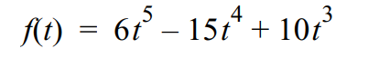
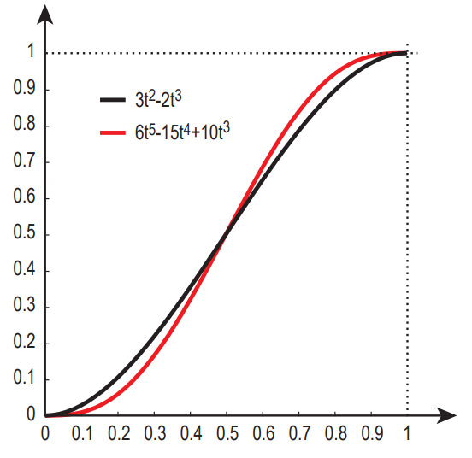
Perlin Noise 2D | Step 3/3
3.1. Bilinear interpolation (fifth order blending curve):
s
t
1) st= mix(s, t, f(x))
2)
uv = mix(u, v, f(x))
3)
Noise = mix(st, uv, f(y))
u
v
Src: S. Gustavson, Simplex noise demystified, http://webstaff.itn.liu.se/~stegu/simplexnoise/simplexnoise.pdf

Slide 15
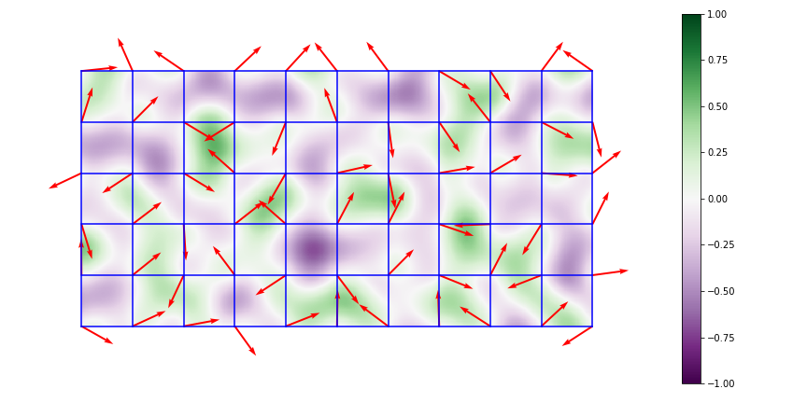
Perlin Noise 2D | Step 3/3
Interpolated result
Source: By Matthewslf - Own work, CC BY-SA 4.0, https://commons.wikimedia.org/w/index.php?curid=77692523

Slide 16
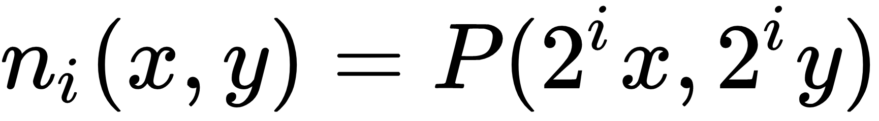
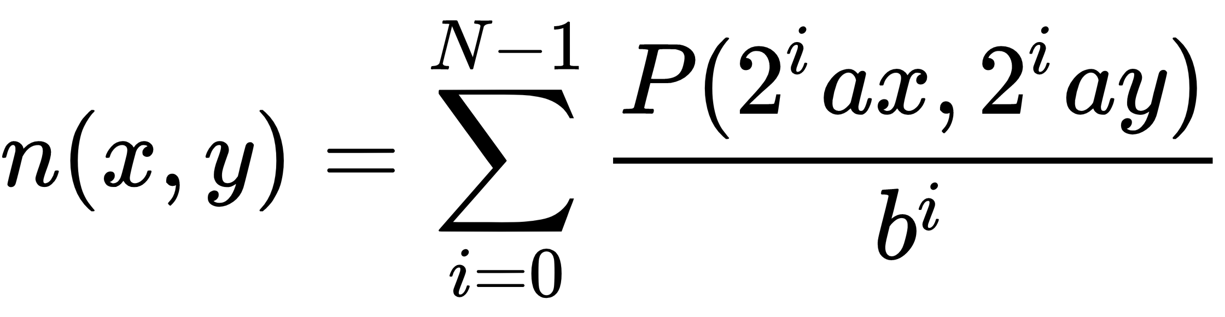
Fractal Noise
+
+
=
Perlin Noise in other frequencies (i.e. different grid sizes) generates a different pattern. A doubling of frequency is a called a “octave”:
→ “More rectangles, more gradient vectors, more detail”
Usage of Perlin Noise for textures is most of the time in form of “Fractal Noise” that is created by adding more octaves of Perlin Noise together:

Slide 17
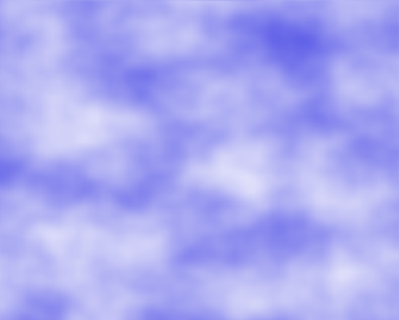

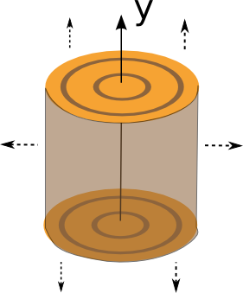
Sky
Using noise values as a blending factor between the background sky color and the cloud color
Using a cosine function for a sharper transition
Wood
Defining a 2D region out of a 3D “virtual log”
Source: David Wolff, https://static.packt-cdn.com/downloads/9781789342253_ColorImages.pdf

Slide 18
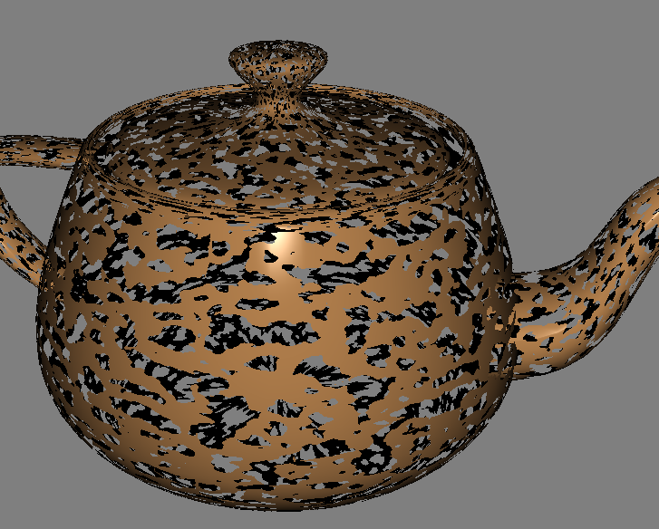
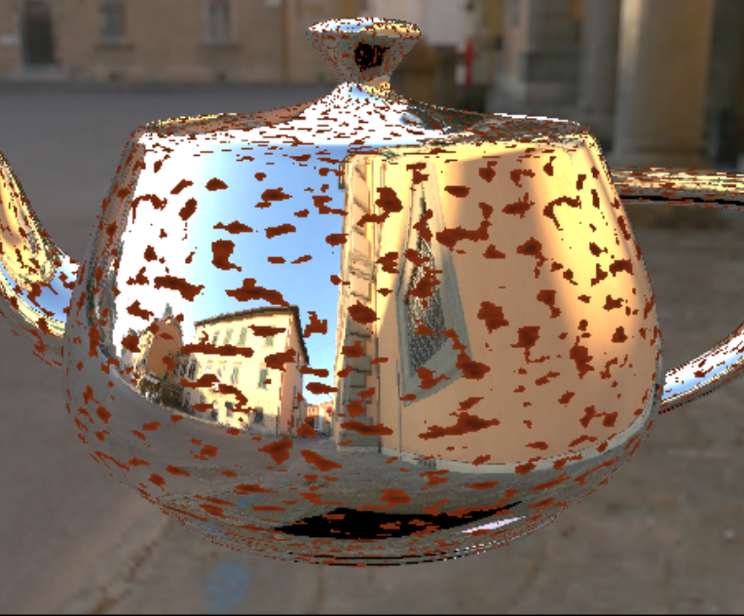
Decay / Erosion
discard fragments that correspond to a noise value that is above or below a certain threshold
Rust
combines a noise texture with the reflection effect from chapter 5
If the noise is above a certain threshold, we'll use the rust color, otherwise, we'll use the reflected color
Source: David Wolff, https://static.packt-cdn.com/downloads/9781789342253_ColorImages.pdf

Slide 19
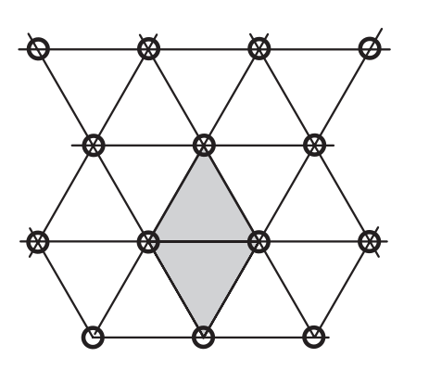
Simplex Noise Vorteile
Enhanced Perlin Noise by Ken Perlin, uses a Simplex grid
• Simplex noise has a lower computational complexity and requires fewer multiplications.
• Simplex noise scales to higher dimensions (4D, 5D and up) with much less computational cost, the complexity is O(N) for dimensions instead of the O (2^N) of classic Noise.
• Simplex noise is easy to implement in hardware.
• Simplex noise has no noticeable directional artifacts.
• Simplex noise has a well-defined and continuous gradient everywhere that can be computed quite cheaply.
https://gist.github.com/patriciogonzalezvivo/670c22f3966e662d2f83
Src: S. Gustavson, Simplex noise demystified, http://webstaff.itn.liu.se/~stegu/simplexnoise/simplexnoise.pdf

Slide 20
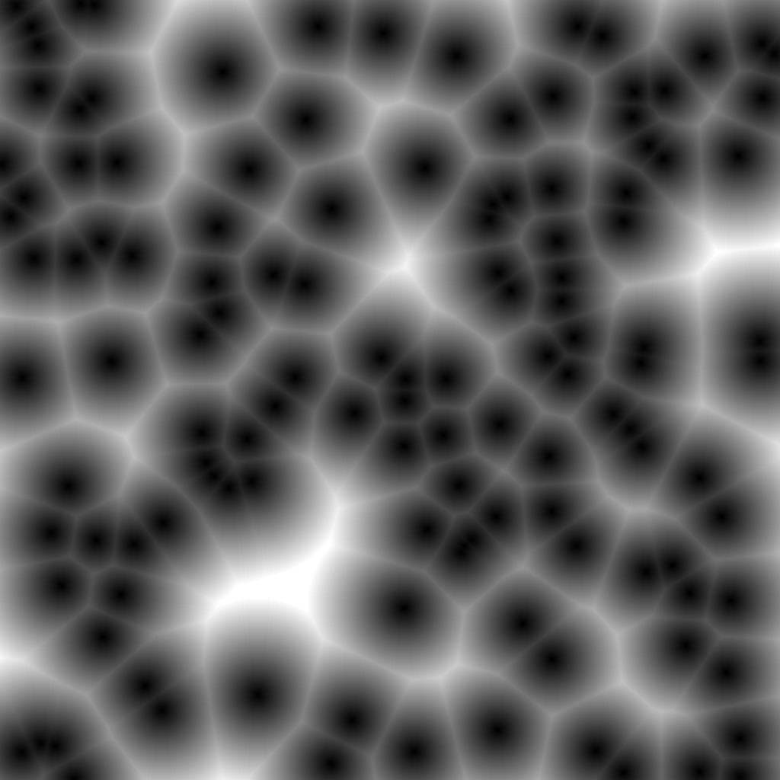
Worley Noise - Steven Worley
Cell-like, more biological looking effects
-> Cells, Plants, Animal scales, Cracked/Dry soil
Source: Von Rocchini - Eigenes Werk, CC BY-SA 3.0, https://commons.wikimedia.org/w/index.php?curid=18968986

Slide 21
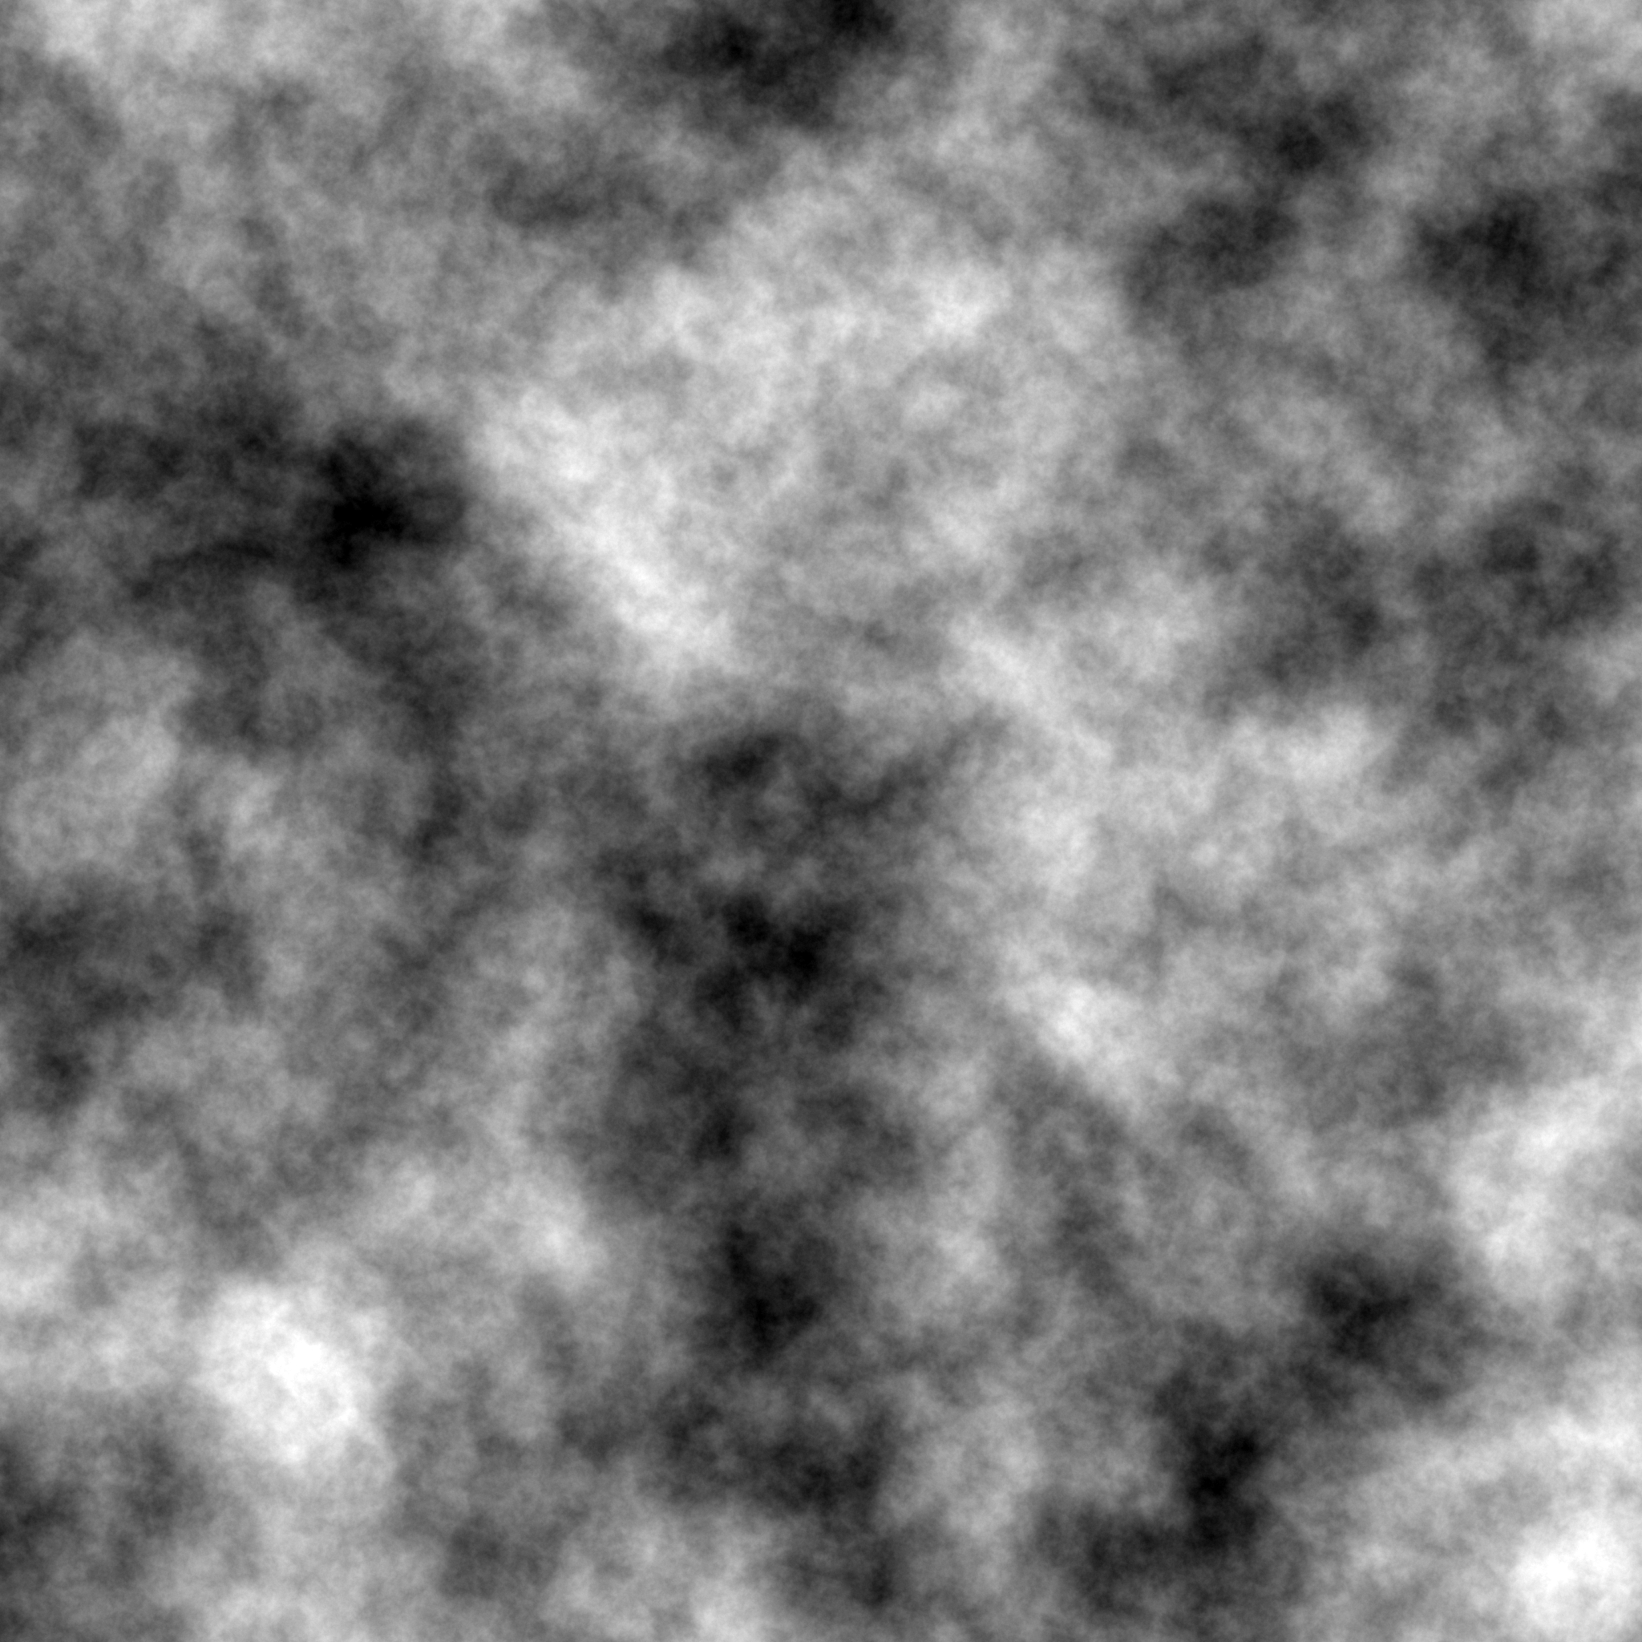
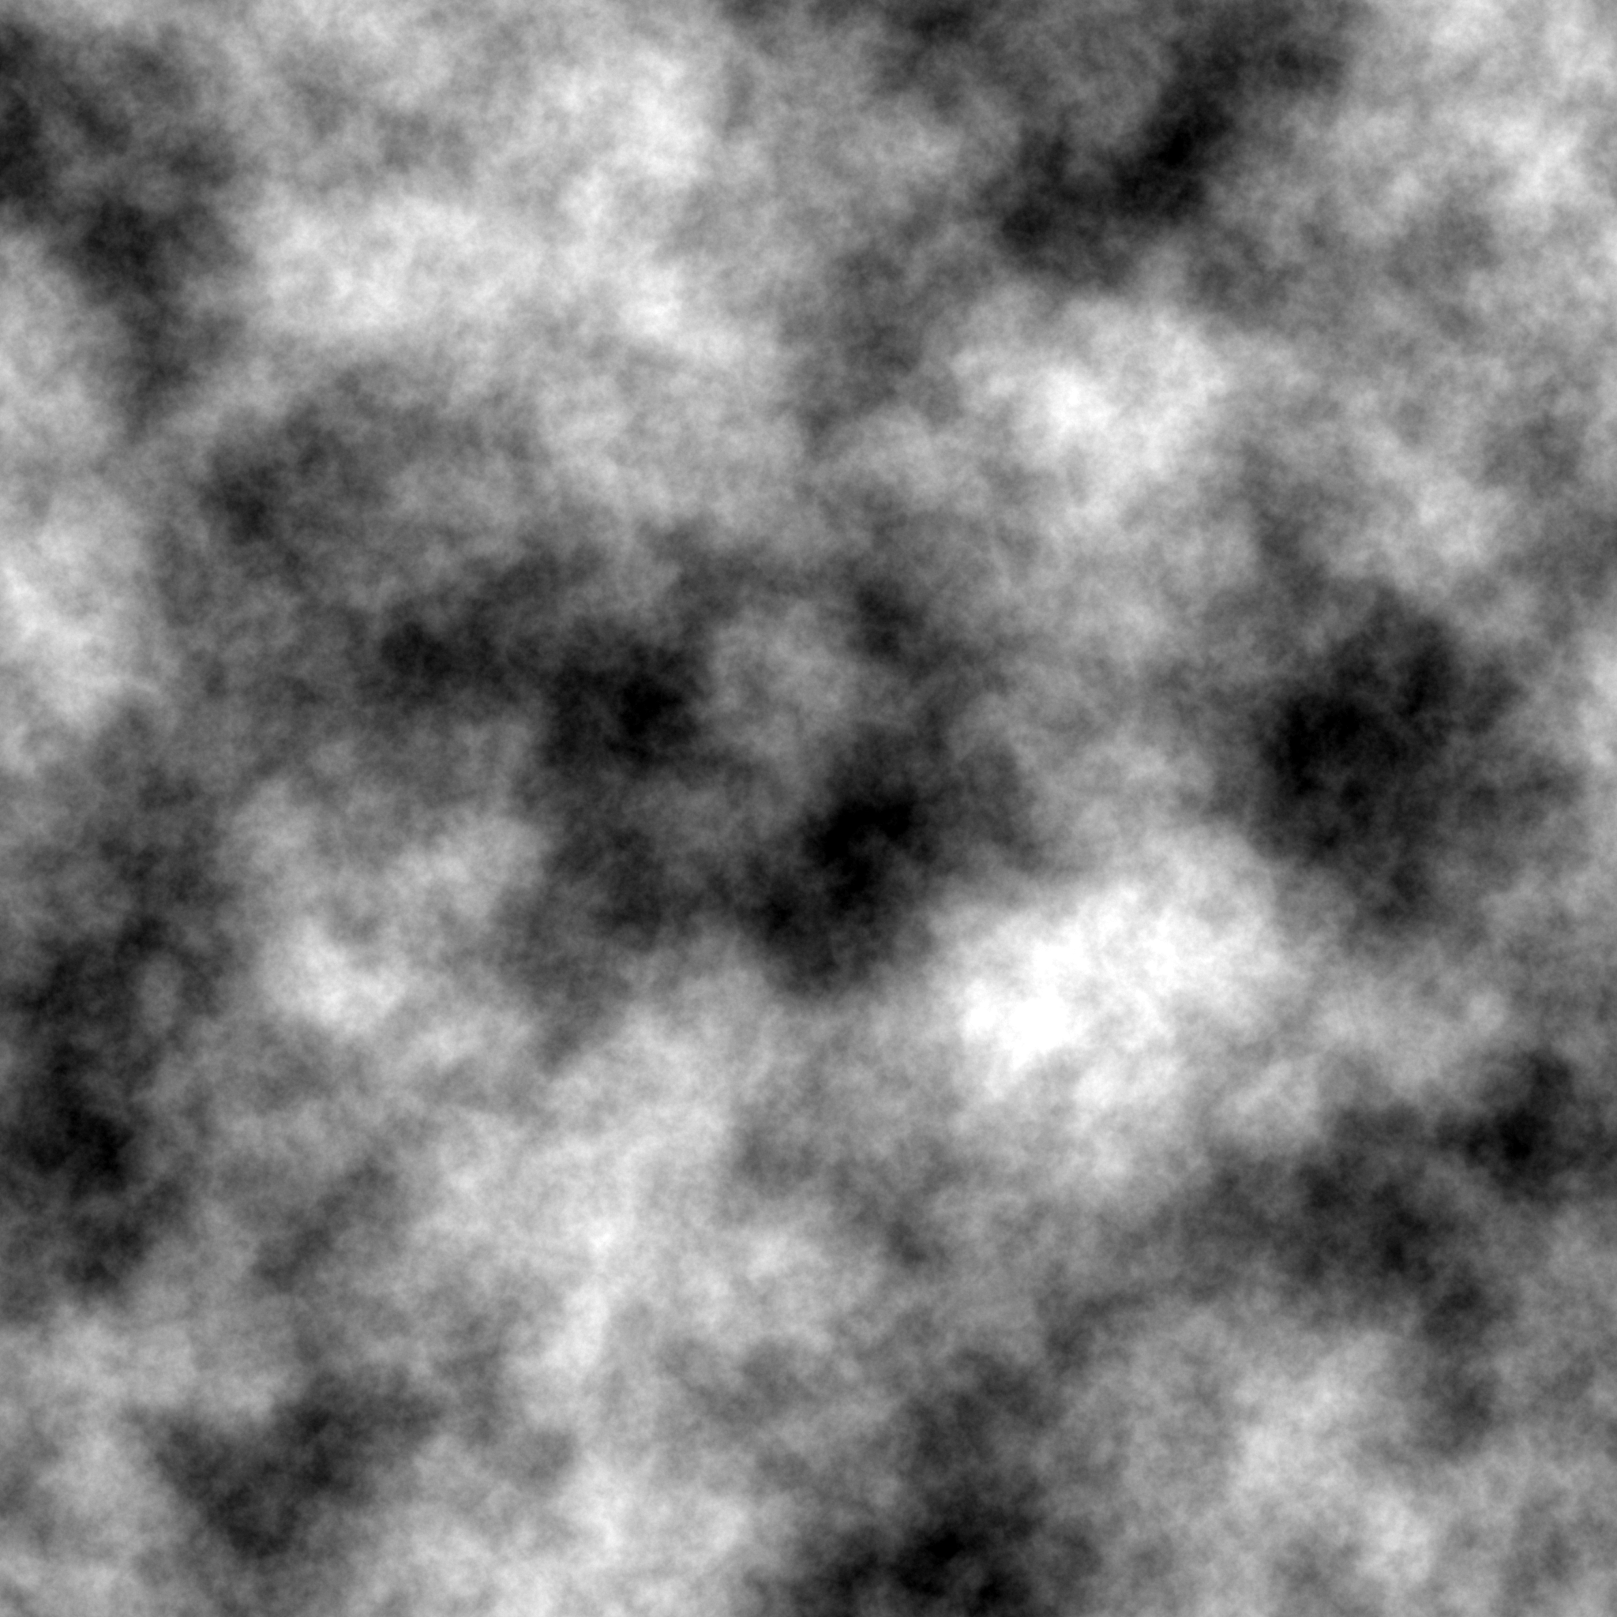
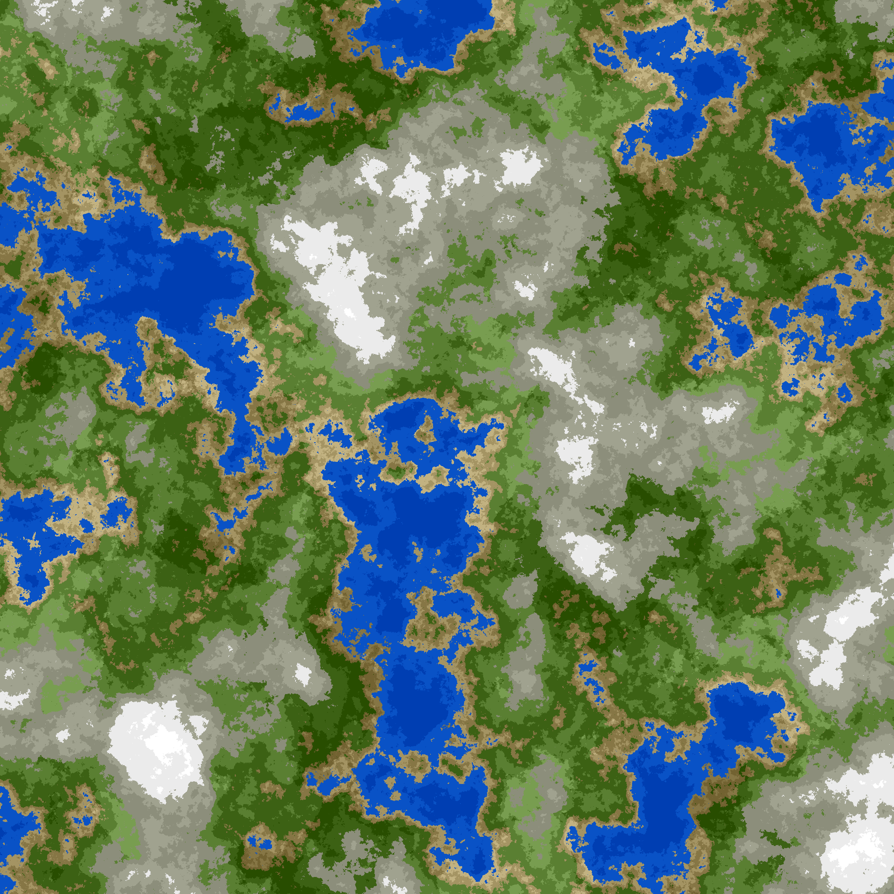
Procedural Terrain Generation
→
&
Combinate island heightmap and moisture heightmap
coloured
Source: Username: Travall, https://medium.com/@travall/procedural-2d-island-generation-noise-functions-13976bddeaf9

Slide 22
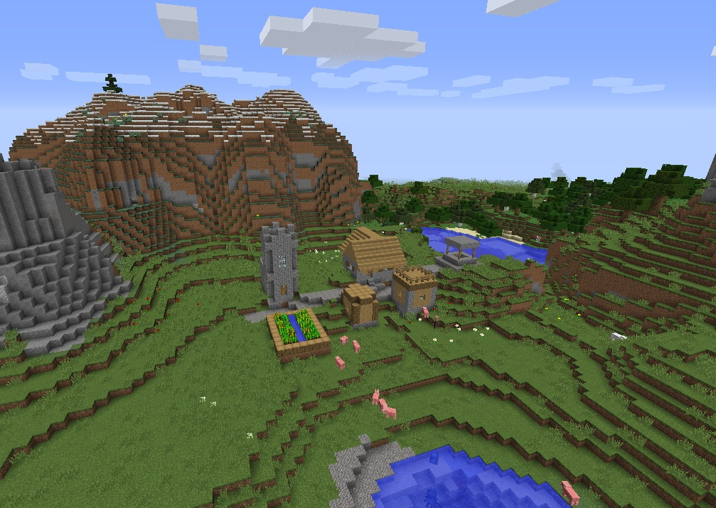
Procedural Terrain Generation
Procedural Terrain Generation with noise functions: Minecraft, Dwarf Fortress, No Man‘s Sky, Don‘t starve, etc.
Source: Admin, https://minecraftvillageseeds.com/wiki/index.php?title=File:Minecraft_mountain_village_forest_plains_seed_1.8.8.jpg#filelinks

Slide 23
Quellen
K. Perlin, Making Noise: Archived from the original. [Online]. Verfügbar unter: https://web.archive.org/web/20071011035810/http://noisemachine.com/talk1/ (Zugriff am: 2. Dezember 2020).
S. Gustavson, Simplex noise demystified. [Online]. Verfügbar unter: http://webstaff.itn.liu.se/~stegu/simplexnoise/simplexnoise.pdf (Zugriff am: 6. Dezember 2020).
K. Perlin, „Improving noise“, ACM Trans. Graph., Jg. 21, Nr. 3, S. 681–682, 2002, doi: 10.1145/566654.566636.
D. Wolff, OpenGL 4 Shading Language Cookbook: Build High-Quality, Real-time 3D Graphics with OpenGL 4. 6, GLSL 4. 6 and C++17, 3rd Edition, 3. Aufl. Birmingham: Packt Publishing Ltd, 2018. [Online]. Verfügbar unter: https://ebookcentral.proquest.com/lib/gbv/detail.action?docID=5532271
Username: Travall, Procedural 2D Island Generation — Noise Functions. [Online]. Verfügbar unter: https://medium.com/@travall/procedural-2d-island-generation-noise-functions-13976bddeaf9 (Zugriff am: 2. Dezember 2020).
Inigo Quilez, voronoise - 2014. [Online]. Verfügbar unter: https://www.iquilezles.org/www/articles/voronoise/voronoise.htm (Zugriff am: 2. Dezember 2020).

